Slide 1
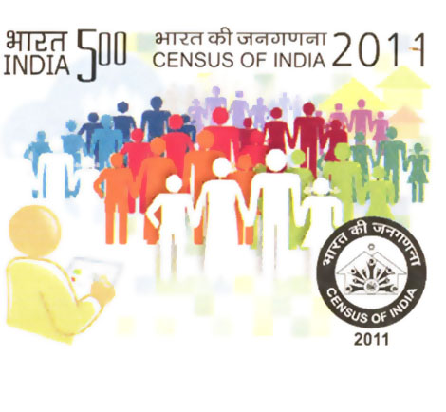

ANALYSIS OF INDIAN CENSUS 2011 DATA A research project by Shreya Basu
Top Ranked Data Science & Analytics Education Provider since 2007

Slide 2
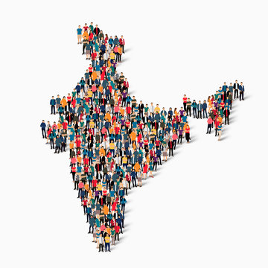
CONTENTS
Introduction
Data Preparation
Objectives
Methodology
Analysis
Insights
Conclusion
Top Ranked Data Science & Analytics Education Provider since 2007

Slide 3

INTRODUCTION
A census is an official survey of the population of the country that is carried out in order to find out how many people live there and to obtain details of such things as people’s ages and jobs.
Census has been conducted in India since 1872 and 2011 marks the first time biometric information was collected. According to the provisional reports released on 31 March 2011, the Indian population increased to 1.21 billion with a decadal growth of 17.70%.
In India the last census held in 2011, whilst the next was to be held in 2021 before it was postponed due to the COVID – 19 pandemic. The next census will be held after the 2024 General Election.
Top Ranked Data Science & Analytics Education Provider since 2007

Slide 4

DATA PREPARATION
The Indian Census 2011 dataset has been sourced from Kaggle datasets.
This dataset comprises 2 files –
Dataset 1 - contains demographic & socio – economic attributes
Dataset 2 - contains geographical & population attributes
The 15th Indian Census was conducted from April 2010 to February 2011 across 28 states & 8 union territories.
Removed the records with null values to ensure data completeness & accuracy.
Total 640 districts have been included in the data.
Top Ranked Data Science & Analytics Education Provider since 2007

Slide 5
OBJECTIVES
To analyze the key demographic trends & socio – economic data of Indian districts.
To utilize SQL functions for data analysis.
To visualize the findings using various charts.
To draw meaningful insights & comparisons between districts & states.
Top Ranked Data Science & Analytics Education Provider since 2007

Slide 6
METHODOLOGY
Description of SQL functions used –
JOIN: To combine data from Dataset1 & Dataset2.
UNION: To merge results from different queries.
DISTINCT: To retrieve unique districts or states
CTE: For creating temporary result sets.
Aggregation Functions: SUM, AVERAGE, MAX, MIN.
GROUP BY & ORDER BY: For grouping & sorting data.
CASE – WHEN: For conditional logic.
Top Ranked Data Science & Analytics Education Provider since 2007

Slide 7
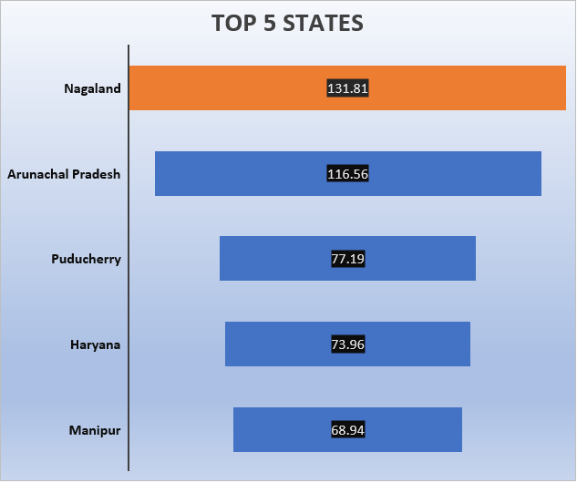
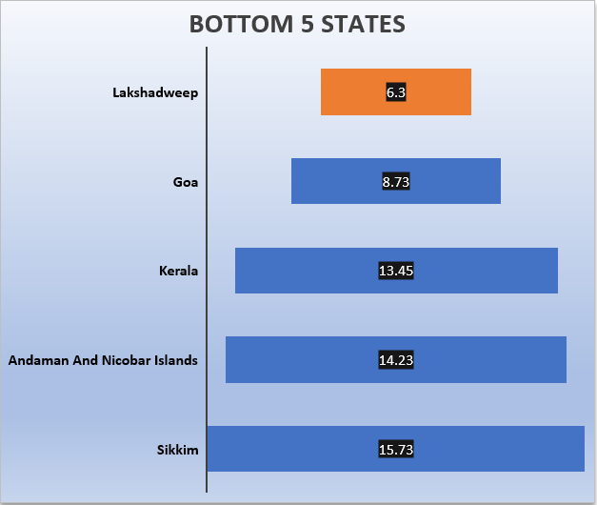
State wise Population Growth Rate
Top Ranked Data Science & Analytics Education Provider since 2007

Slide 8
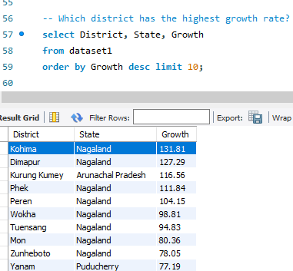
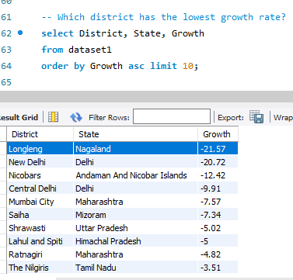
Top 10 Districts with Highest & Lowest Growth Rates
KOHIMA & LONGLENG are the two districts of Nagaland with highest & lowest growth rate recorded, respectively.
Top Ranked Data Science & Analytics Education Provider since 2007

Slide 9
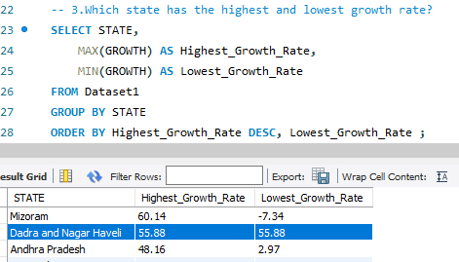
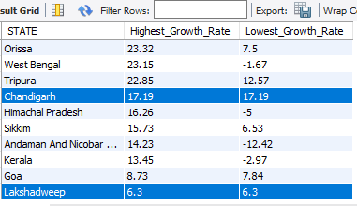
Analysis of Population Growth Rate
While Nagaland has the highest as well as lowest growth rate, Dadra Nagar Haveli (55.88), Chandigarh(17.19) & Lakshadweep(6.3)maintained the same growth rate over the period.
Only Korba of Chhattisgarh matched the National Average Growth rate of population is 19.25.
263 districts recorded higher population growth rate compared to the national level.
376 districts recorded population growth rate lower than the national level.
Top Ranked Data Science & Analytics Education Provider since 2007

Slide 10
State wise Average Sex Ratio
Top Ranked Data Science & Analytics Education Provider since 2007

Slide 11
Analysis of Sex Ratio
The National Average Sex Ratio is 945.
19 States & UTs come under Above National Average Sex Ratio.
16 States & UTs come under Below National Sex Ratio.
Sex Ratio is defined as no. of females per 1000 males in the population
The National Average Sex Ratio is 945.
19 States & UTs come under Above National Average Sex Ratio.
16 States & UTs come under Below National Average Sex Ratio.
Kerala secured the highest sex ratio in the country.
District wise Mahe (Puducherry) & Daman recorded the highest & lowest sex ratio, respectively.
Top Ranked Data Science & Analytics Education Provider since 2007

Slide 12
Literacy Rate vs. Total Population by State
Top Ranked Data Science & Analytics Education Provider since 2007

Slide 13
Correlation Between Literacy Rate & Growth Rate
Top Ranked Data Science & Analytics Education Provider since 2007

Slide 14
No. of Districts in Different Literacy Range
Literacy Rate
40% - 50% Poor
50% - 60% Average
60% - 70% Moderate
70% - 80% High
80% - 90% Very High
Above 90% Outstanding
Top Ranked Data Science & Analytics Education Provider since 2007

Slide 15
Analysis of Literacy Rate
According to the dataset the average national literacy rate is 70%.
The state - wise literacy rate & population growth rate are negatively correlated.
Districts with higher (70% - 80%) literacy rates are notable.
Overall literacy rate has been increased in India but higher population levels can be an obstacle to achieving an elevated literacy rate.
Top Ranked Data Science & Analytics Education Provider since 2007

Slide 16
State wise Population Density
Top Ranked Data Science & Analytics Education Provider since 2007

Slide 17
Analysis of Population Density
The contrast between the highest & the lowest population density underscores the diverse population distribution across India’s regions.
The disparity in population density highlights the varying degrees of urbanization & habitation patterns within the country.
The low population density indicates the presence of vast , uninhabited or lightly inhabited terrains, often due to geographical & climatic conditions.
Top Ranked Data Science & Analytics Education Provider since 2007

Slide 18
Comparison among Metro Cities of India
Top Ranked Data Science & Analytics Education Provider since 2007

Slide 19
Comparison among Metro Cities of India
Chennai indicates extreme urban density & potential infrastructural stress compared to other metro cities.
The high population density in urban areas reflect the trend of urban migration & the concentration of economic activities in cities.
Top Ranked Data Science & Analytics Education Provider since 2007

Slide 20
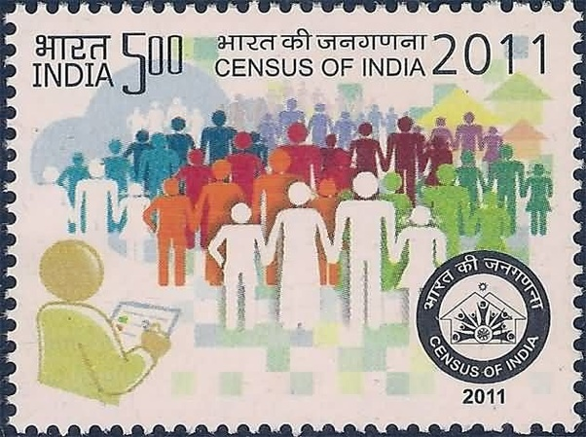
INSIGHTFUL SUGGESTIONS
Promote family planning & incentivize smaller families.
Women empowerment through improved female health services, education & employment opportunities for women.
Enhance educational infrastructure.
Prevent gender – based discrimination.
Rural development.
Urban planning & development.
Top Ranked Data Science & Analytics Education Provider since 2007

Slide 21
Thank You
Top Ranked Data Science & Analytics Education Provider since 2007

